Slide 1
Business-model Core

Slide 2
Step №1. General description of project
Describe your project in 3-4 sentences.
/

Slide 3
Step №2. Answer for 5 questions
What is the most promising direction of actions? | A | Green tourism. Connection tourists and farmhouses
What do you want to achieve in the nearest period of planning (week/month, quarter)? | S | It’s something that tourists can enjoy when they come here. Discover what tourists program aere wxists
What value do you bring and to whom? | Pi | Clients: Citizens of other cities. Value: Come for leisure and entertainment Fishing, crayfish fishing, visiting the largest dam on the Asian plains, etc.
What resources must be spent to deliver value to your clients? | R | Money:1 million from government and 500,000 yuan from company Staff: 10 people in the travel company, but the staff of the supporting restaurants are not included. Management operations, driving staff, reception staff Technologies and other material resources you need: Publicity effects Office: management and publicity
What indicators must be monitored to achieve success? | In | Number of tourists Revenue and expenses of each operating link Visitor second visit rate

Slide 4
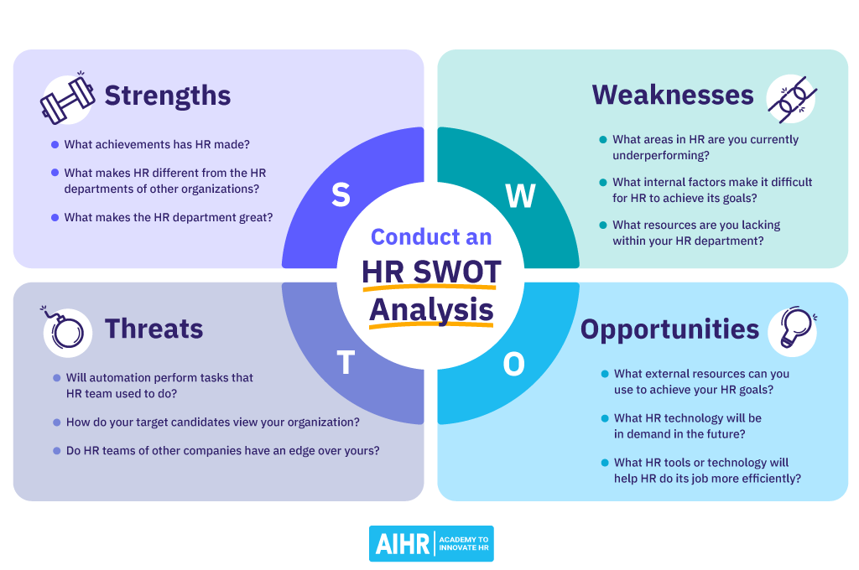

Slide 5
TOWS - analysis |  | Strengths | Weaknesses
 |  | Skills that you already have to realisation your project: | Skills that you don’t have now, but it would be better to realisation your project:
 |  | SO | WO
Opportunities | Outer resources, that can get to realisation your project: | List of the most promising directions | List of development priority (what to change)
Threats | Conditions, organisations and other factors, that don’t depends of you, but that can make a negative influence to your project: | Training plan (list of actions) | Avoidance (list of actions that you are avoidance ever)
 |  | ST | WT

Slide 6
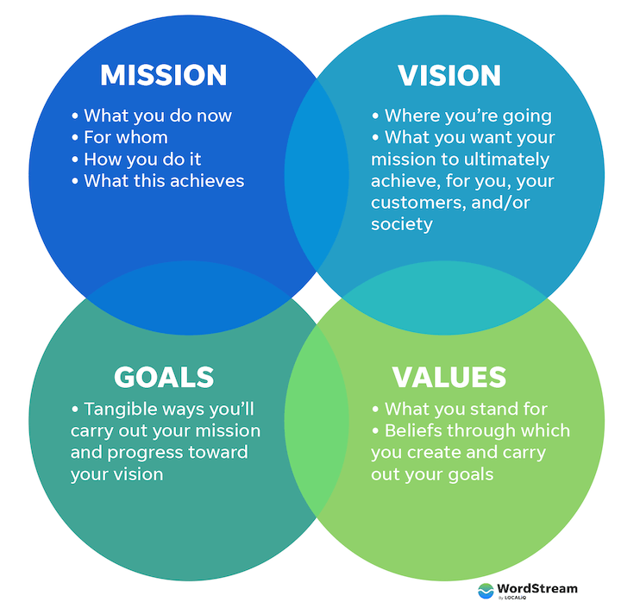

Slide 7
Mission (what is all this for?)
Vision (as you see the result in 5+ years)
Values (what principles do you think are correct and they bring results)
Strategy (what is the sequence of stages from vision to today)

Slide 8
Goal (what to try to achieve at the first stage)
S (specific: name a working analogue, what will be similar and what will differ)
M (Measurable: describe the goal in numbers)
A (Achievable: what actions must be taken to achieve)
R (Relevant: name 2-3 more variants of possible goals that are possible but less valuable)
T (Time-Bound: limit the achievement of the goal to a certain time)

Slide 9
Target audience (TA)
 |  | Pains | Pain
Customer jobs |  |  |  |  | Products& Services
 |  | Gains | Генератори вигід

Slide 10
Resourses: UNIT Economics
 |  | Costs | Customer acquisition cost (CAC) | Price | Profit
For 1 product | 1 | 95 | 22 | 140 | 140-22-95=23
n products are made by 1 employee Per week | 4 | =n*cost (cost per 1 employee) 380 | = n*CAC (marketing and sales expenses per 1 employee) 88 | =n*pice (revenue of 1 employee) 480 | =n*profit (profit per 1 employee) 92
There are k employees | 2 | =k*n*cost (gross cost) 760 | = k*n*CAC (gross marketing and sales expenses) 178 | = k*n*CAC (gross revenue) 960 | =k*n*profit (gross profit) 194
Notes:
Структура організації, Перелік основних команд, P&L, Unit Economics, ROI, ROMI

Slide 11
Indication: Dashboard | Quartal Plan | Month plan | Weekly plan
Sales
Number of sales | 375 | 100 | 25
Conversion rate (lead to sale) CR | 0.02 | 0.02 | 0.02
Number of leads | 15000 | 5000 | 1250
Average sales price (5% of price) | 150 | 0.5*100=50 | 12,5
Costs
Cost per unit (cost) | 135 | 140 | 140
Products for 1 employee have been created | 5 | 4 | 4
Number of employees (k) | 7 | 7 | 7
Finances result
Profit/loss | 8625 | 2300 | 575
Leading indicators (for travel blog)
Indicator 1 (time of recording) | 48 | 16 | 4
Indicator 2 (time of make up) | 144 | 48 | 12
Indicator 3 (number of comments)
Number of travels
Number of publications | 12 | 4 | 1
Hours of recording per 1 publication | 4 | 4 | 4
Notes:
Розклад зустрічей основних команд, розклад зустрічей 1 на 1, таск-трекер

